Slide 1
Cryptocurrency price prediction using Machine learning
Guided by: Mrs.K.Amsavalli, M.E,(Ph.D.),
Team Members:
1.Gurupradeep.G(310119104033)
2.Harishvaran. M(310119104036)

Slide 2
AGENDA
Abstract
Introduction
Problem statement
Objective & Scope
Literature Survey
Existing System
Proposed System
Overall Architecture
Modules
Implementation and Result
Screenshot
Conclusion
Reference

Slide 3
ABSTRACT
Bitcoin, the ruler of cryptocurrency plays an important role in blockchain technology. - In this project, proposed to predict the Bitcoin price accurately taking into consideration various parameters that affect the Bitcoin value.
To aim to understand and find daily trends in the Bitcoin market while gaining insight into optimal features surrounding Bitcoin price. Our data set consists of various features relating to the Bitcoin price and payment network over the course of every year, recorded daily.
Features such as the opening price, highest price, lowest price, closing price, the volume of Bitcoin, the volume of currencies, and weighted price were taken into consideration to predict the closing price of the next day.
The future of bitcoin is predicted as a result of today's real-time data.

Slide 4
INTRODUCTION
Bitcoin is a cryptographic money that is utilized worldwide for advanced installment or basically for speculation purposes.
Bitcoin is decentralized for example it isn't possessed by anybody.
Bitcoins are put away in an advanced wallet which is essentially similar to a virtual financial balance. The record of the considerable number of exchanges, the timestamp information is put away in a spot called Blockchain. Each record in a blockchain is known as a square.
The information on the blockchain is scrambled. During exchanges the client's name isn't uncovered, however just their wallet ID is made open. The Bitcoin's worth fluctuates simply like a stock though in an unexpected way.
We will predict the sign of the daily price change with the highest possible accuracy.

Slide 5
Problem statement
The challenge in Bitcoin price prediction using ml is to develop a model that can effectively capture the complex and non-linear relationships between the input features and Bitcoin prices.
High computational resources and a large amount of training data to achieve accurate results.
Unpredictable nature of the cryptocurrency market makes it difficult to develop a model that can provide reliable predictions.

Slide 6
Objective
To develop a machine learning model that can accurately predict the prices of cryptocurrencies based on historical data and various other relevant features.
To analyze the performance of different machine learning algorithms such as linear regression, neural networks, and decision trees to determine the best algorithm for the cryptocurrency price prediction task.
To identify and extract the most relevant features that can have a significant impact on the cryptocurrency prices, including market trends, trading volumes, social media sentiment, and news articles.
To evaluate the accuracy of the model using appropriate performance metrics such as mean squared error, mean absolute error, and R-squared, and to fine-tune the model to achieve the highest possible accuracy.

Slide 7
Scope
Bitcoin’s value varies just like a stock albeit differently. There are several algorithms used on stock market data for price prediction. However, the parameters affecting Bitcoin are different. Therefore it is necessary to predict the value of Bitcoin so that correct investment decisions can be made.
The price of Bitcoin does not depend on business events or intervening government, unlike the stock market. Thus, to predict the value we feel it is necessary to leverage machine learning technology to predict the price of Bitcoin.

Slide 8
LITERATURE SURVEY REVIEW
Sno. | Title | Author | Algorithm | Category | Parameters/Data sets | Preprocessing Technique | Accuracy | Pros | Cons
1 | Bitcoin price prediction using machine learning: An approach to sample size selection | O. I. Oladipo, A. R. Akinwale, O. J. Oyeyemi, & O. D. Samuel | Support Vector Regression (SVR) | Regression | Closing price, Volume, Market capitalization, Number of bitcoins in circulation | Normalization | R2 of 0.96 | Good accuracy | limited to linear relationships

Slide 9
Sno. | Title | Author | Algorithm | Category | Parameters/Data sets | Preprocessing Technique | Accuracy | Pros | Cons
2 | Bitcoin price prediction using deep learning models | Y. Chen, H. Xu, & W. Zhou | convolutional Neural Network (CNN), Recurrent Neural Network (RNN) | Time series forecasting | closing price, Volume, Market capitalization | Standardization, PCA | Best MAE of 95.53 achieved by CNN-LSTM | Good accuracy | Limited feature selection

Slide 10
Sno. | Title | Author | Algorithm | Category | Parameters/Data sets | Preprocessing Technique | Accuracy | Pros | Cons
3 | comparative analysis of machine learning algorithms for bitcoin price prediction | T. O. Faparusi & M. O. Adetunmbi | Random Forest (RF), Artificial Neural Network (ANN), SVR, Linear Regression (LR) | Regression | Open price, High price, Low price, Closing price, Volume, Market capitalization, Number of transactions | standardization, PCA | Best R2 of 0.94 achieved by R | Multiple algorithms tested | Limited feature selection

Slide 11
Sno. | Title | Author | Algorithm | Category | Parameters/Data sets | Preprocessing Technique | Accuracy | Pros | Cons
4 | Bitcoin price prediction using machine learning algorithms | P. Mishra, M. K. Jena, & B. P. Padhy | Long Short-Term Memory (LSTM) | Time series forecasting | Closing price | Standardization, PCA | MAPE of 3.3% | Good accuracy | Sensitive to input data, prone to overfitting

Slide 12
Existing system
The problem will be solved by achieved with a level of success through the high implementation of a Bayesian regression.
To optimize recurrent neural network (RNN) and a Long Short Term Memory (LSTM) network. The LST Achieves the highest classification accuracy of 52% and an RMSE of 8%.
The popular ARIMA model for time series forecasting is implemented as a comparison to the deep learning models
As expected, the non-linear deep learning methods outperform the ARIMA forecast which performs very low. So, Finally, both learning models resulted in outcomes with are very low level of accuracy.

Slide 13
DISADVANTAGES OF THE EXISTING SYSTEM
One drawback is there is no proof of transaction.
Conversion will be late.
It takes a long time to solve the data set.
It is a long process to filter the data.
Low redundancy to perform the prediction.

Slide 14
PROPOSED SYSTEM
In this study, we have used 5 years of data sets for Bitfinex for testing and training the ML. With the help of python libraries, the data preprocessing was done.
Python has provided the best feature for data Analysis and visualization. After understanding of the data, we trim the data and use the features or attributes best suited for the model.
It was discovered that the random forest model’s accuracy rate is very high when compared to other Machine Learning models from related works.

Slide 15
ADVANTAGES OF THE PROPOSED SYSTEM
The Advantage of RF in Bitcoin price prediction results has been showing with good RMSE and MSE values.
It helps to understand the results very neatly on the webpage.
It works the prediction by taking the ‘URL': 'https://bitinfocharts.

Slide 16









SYSTEM ARCHITECTURE FOR PROPOSED SYSTEM
Training
Evaluation
DataSet
Machine learning
Algorithm
Web scraping
Data pre-processing
Splitting sample
Testing
Final Bitcoin
Prediction

Slide 17
Modules
Dataset Analysis
Data Pre-Processing
Test/Train
Web Scrapping

Slide 18
DATASET ANALYSIS
OPEN PRICE: The open represents the first price traded during the candlestick.
HIGH PRICE: The high is the highest price traded during the candlestick.
LOW: The low shows the lowest price traded during the candlestick.
CLOSE: The close is the last price traded during the candlestick.
Volume (BTC): Volume, in BTC traded in the stock market during a given measurement interval.
Volume (Currency): Volume, in USD, traded on the stock market during a given measurement interval.
Weighted Price: Measure of the average price

Slide 19
Dataset Pre-processing
Remove unwanted columns
Check nan values.

Slide 20
TRAINING & TESTING TRAINING
Now we will fit the Random forest algorithm to the training set. To fit it, we will import the RandomForestClassifier class from sklearn.ensemble library.
Grid search is a process that searches exhaustively through a manually specified subset of the hyperparameter space of the targeted algorithm. Random search, on the other hand, selects a value for each hyperparameter independently using a probability distribution

Slide 21
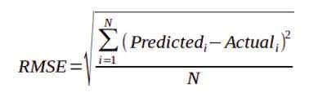
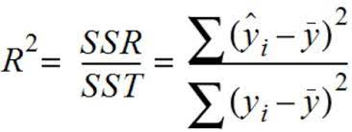
MODEL TRAINING & TESTING TESTING
RMSE (Root Mean Square Error) - Root mean square error (RMSE) is a frequently used measure of the differences between values (sample or population values) predicted by a model or an estimator and the values observed.
r (Pearson’s Correlation Coefficient) The Pearson’s correlation coefficient depicts the linear association between two variables. It helps to figure if two sets of data move in the same direction.

Slide 22
Web Scrapping
Send an HTTP request to the URL of the webpage you want to access. The server responds to the request by returning the HTML content of the webpage. For this task, we will use a third-party HTTP library for python-requests.
Once we have accessed the HTML content, we are left with the task of parsing the data. Since most of the HTML data is nested, we cannot extract data simply through string processing. One needs a parser that can create a nested/tree structure of the HTML data. There are many HTML parser libraries available but the most advanced one is html5lib
Now, all we need to do is navigate and search the parse tree that we created, i.e. tree traversal. For this task, we will be using another third-party python library, Beautiful Soup. It is a Python library for pulling data out of HTML and XML files.

Slide 23
SOFTWARE REQUIREMENT
Hardware
Windows 7,8,10 64 bit
Ram 4GB
Software
Python 3.7
Flask framework
Python’s standard library
Pandas
Numpy

Slide 24
IMPLEMENTATION AND RESULTS
For the purposes of this project we have used two algorithm Logistic regression and Random Forest Algorithm.
All the algorithms are based on supervised learning. We are determining the best method considering factor namely Accuracy.
When plotted on a graph for two the algorithms it was found that Random Forest Algorithm was the best method to use to find Cryptocurrency price prediction.

Slide 25

SCREENSHOTS

Slide 26


Slide 27
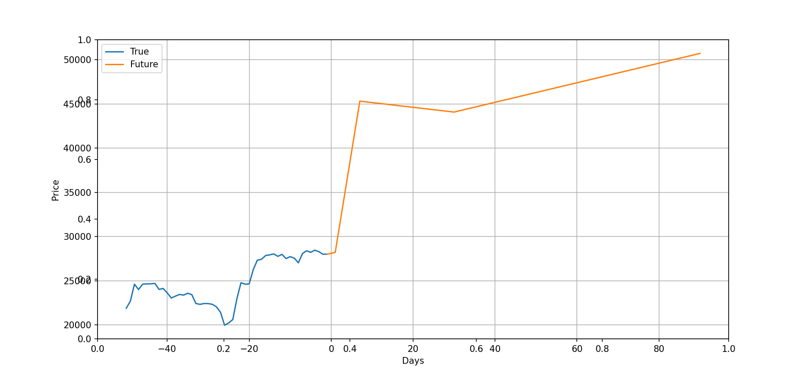

Slide 28
CONCLUSIONS
Based on the project's findings, it is evident that Bitcoin's price is influenced by various factors. The proposed predictive model, which incorporates multiple parameters, was able to accurately forecast Bitcoin's closing price for the following day. The model can be helpful for investors and traders looking to make informed decisions about buying or selling Bitcoin. Furthermore, the project highlights the importance of data analysis and machine learning in understanding and predicting trends in the cryptocurrency market. As blockchain technology continues to evolve, it is likely that Bitcoin will remain a crucial player and that its value will continue to fluctuate. By monitoring and analyzing relevant data points, we can gain insights into the future of Bitcoin and the wider cryptocurrency market.

Slide 29
REFERENCE
Real-Time Prediction of BITCOIN Price using Machine Learning Techniques and Public Sentiment Analysis S M Rajua Ali Mohammad Tarif.
Prediction of Bitcoin Prices with Machine Learning Methods using Time Series Data Zonguldak, Türkiye 2018 IEEE
Akyildirim, Erdinc, Oguzhan Cepni, Shaen Corbet, and Gazi Salah Uddin. 2021. Forecasting mid-price movement of Bitcoin futures using machine learning. Annals of Operations Research, 1–32.
Parvez, Shaik Javed. 2022. Bitcoin price prediction using Random Forest Regression. Journal of Positive School Psychology 6: 4352–58.
Nakamoto, Satoshi. 2008. Bitcoin: A Peer-to-Peer Electronic Cash System. Available online: https://bitcoin.org/bitcoin.pdf (accessed on 7 October 2022).

